Slide 1
INCREASE WOT IMPACT USING TRANSFERABLE VALIDATION
Ben De Meester, Gerald Haesendonck (gerald.haesendonck@ugent.be),
Ruben Verborgh, and Anastasia Dimou
Ghent University – imec – IDLab, Belgium

Slide 2
Validation for WoT
Thing Description data schema
{"definitions": {
"thing-context-w3c-uri": {
"type": "string",
"enum": [ "https://www.w3.org/2019/wot/td/v1" ] },
"thing-context": {
"oneOf": [
{ "type": "array",
"items": {
"anyOf": [{ "$ref": "#/definitions/anyUri" }, { "type": "object" } ] },
"contains": { "$ref": "#/definitions/thing-context-w3c-uri" } },
{ "$ref": "#/definitions/thing-context-w3c-uri" } ] },
"type_declaration": {
"oneOf": [
{ "type": "string" },
{ "type": "array", "items": { "type": "string" } } ] },
"property_element": {
"type": "object", "properties": {
"@type": { "$ref": "#/definitions/type_declaration" },
"description": { "$ref": "#/definitions/description" },
Notes:
A central building block in the WoT is the Thing Description, which explains how to interact with Things, and how the data model of a Thing looks like.
What you see here is a semantic TD data schema. This allows - among others - linking Things to pre-existing Linked Data sets.
However, these data sets would have to be assessed or validated somehow against this data schema vocabulary.

Slide 3
Validation for Linked Data
SHACL (W3C recommendation)
<#shape>
sh:property [ sh:path <#thing-context-w3c-uri> ;
sh:datatype xsd:string ;
sh:in ( "https://www.w3.org/2019/wot/td/v1" )
] , [ sh:path <#thing-context> ;
sh:or (
[ sh:node shsh:listA ]
[ sh:node <#thing-context-w3c-uri-shape> ] ) .
shsh:listA shsh:or ( <#anyUri-shape> <#object-shape> ) .
<#shape>
sh:property [ sh:path <#type_declaration> ;
sh:or (
[ sh:datatype xsd:string ] ;
[ sh:node shsh:listB ] ) ] .
shsh:listB shsh:datatype xsd:string .
<#shape>
sh:property [ sh:path <#property_element> ;
sh:node <#property_element-shape> ] .
<#property_element-shape>
sh:property [ sh:path
Notes:
W3C recommends SHACL to describe general data shapes.
For Linked Data sets that are described using SHACL shapes, validation is already in place

Slide 4
Validation mismatch
TD data schema
{"definitions": {
"thing-context-w3c-uri": {
"type": "string",
"enum": [ "https://www.w3.org/2019/wot/td/v1" ] },
"thing-context": {
"oneOf": [
{ "type": "array",
"items": {
"anyOf": [{ "$ref": "#/definitions/anyUri" }, { "type": "object" } ] },
"contains": { "$ref": "#/definitions/thing-context-w3c-uri" } },
{ "$ref": "#/definitions/thing-context-w3c-uri" } ] },
"type_declaration": {
"oneOf": [
{ "type": "string" },
{ "type": "array", "items": { "type": "string" } } ] },
"property_element": {
"type": "object", "properties": {
"@type": { "$ref": "#/definitions/type_declaration" },
"description": { "$ref": "#/definitions/description" },
SHACL
<#shape>
sh:property [ sh:path <#thing-context-w3c-uri> ;
sh:datatype xsd:string ;
sh:in ( "https://www.w3.org/2019/wot/td/v1" )
] , [ sh:path <#thing-context> ;
sh:or (
[ sh:node shsh:listA ]
[ sh:node <#thing-context-w3c-uri-shape> ] ) .
shsh:listA shsh:or ( <#anyUri-shape> <#object-shape> ) .
<#shape>
sh:property [ sh:path <#type_declaration> ;
sh:or (
[ sh:datatype xsd:string ] ;
[ sh:node shsh:listB ] ) ] .
shsh:listB shsh:datatype xsd:string .
<#shape>
sh:property [ sh:path <#property_element> ;
sh:node <#property_element-shape> ] .
<#property_element-shape>
sh:property [ sh:path
# Languages
# Tools
Notes:
So at first sight there seems to be a validation mismatch:
for Things there is a TD with a certain data schema,
and for Linked Data there are validation languages like SHACL, and tools to perform validation using these languages.
Can we transfer validation between these languages?

Slide 5
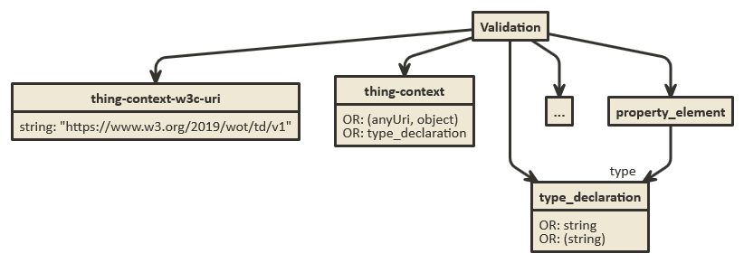
Validation mismatch... or not?
Thing Description
SHACL
Large overlap
Notes:
But, there seems to be a large overlap, if you look at *what* they describe.

Slide 6
Mapping is needed
TD data schema
{"definitions": {
"thing-context-w3c-uri": {
"type": "string",
"enum": [ "https://www.w3.org/2019/wot/td/v1" ] },
"thing-context": {
"oneOf": [
{ "type": "array",
"items": {
"anyOf": [{ "$ref": "#/definitions/anyUri" }, { "type": "object" } ] },
"contains": { "$ref": "#/definitions/thing-context-w3c-uri" } },
{ "$ref": "#/definitions/thing-context-w3c-uri" } ] },
"type_declaration": {
"oneOf": [
{ "type": "string" },
{ "type": "array", "items": { "type": "string" } } ] },
"property_element": {
"type": "object", "properties": {
"@type": { "$ref": "#/definitions/type_declaration" },
"description": { "$ref": "#/definitions/description" },
SHACL
<#shape>
sh:property [ sh:path <#thing-context-w3c-uri> ;
sh:datatype xsd:string ;
sh:in ( "https://www.w3.org/2019/wot/td/v1" )
] , [ sh:path <#thing-context> ;
sh:or (
[ sh:node shsh:listA ]
[ sh:node <#thing-context-w3c-uri-shape> ] ) .
shsh:listA shsh:or ( <#anyUri-shape> <#object-shape> ) .
<#shape>
sh:property [ sh:path <#type_declaration> ;
sh:or (
[ sh:datatype xsd:string ] ;
[ sh:node shsh:listB ] ) ] .
shsh:listB shsh:datatype xsd:string .
<#shape>
sh:property [ sh:path <#property_element> ;
sh:node <#property_element-shape> ] .
<#property_element-shape>
sh:property [ sh:path
Notes:
A mapping from and to Thing Descriptions and SHACL shapes is needed,
and we have to investigate whether such a mapping exists.
Once we have that mapping, a set of unambiguous rules can be specified.
We have a piece of software, called Validatrr, that uses these rules to provide validation for both TD data schema and SHACL,
and provides translated versions between them.

Slide 7
Better integration WoT and Linked Data
Complementary
Integrate Linked Data sets with WoT
Using the mapping, you can validate both:
https://idlabresearch.github.io/validatrr/
Notes:
This allows better integration of WoT and Linked Data
Validation is complementary
Things described using TDs can be linked to (pre-existing) Linked Data sets
Using the mapping, you can validate both using Validatrr.

Slide 8
INCREASE WOT IMPACT USING TRANSFERABLE VALIDATION
Ben De Meester, Gerald Haesendonck (gerald.haesendonck@ugent.be),
Ruben Verborgh, and Anastasia Dimou
Ghent University – imec – IDLab, Belgium

